Slide 1
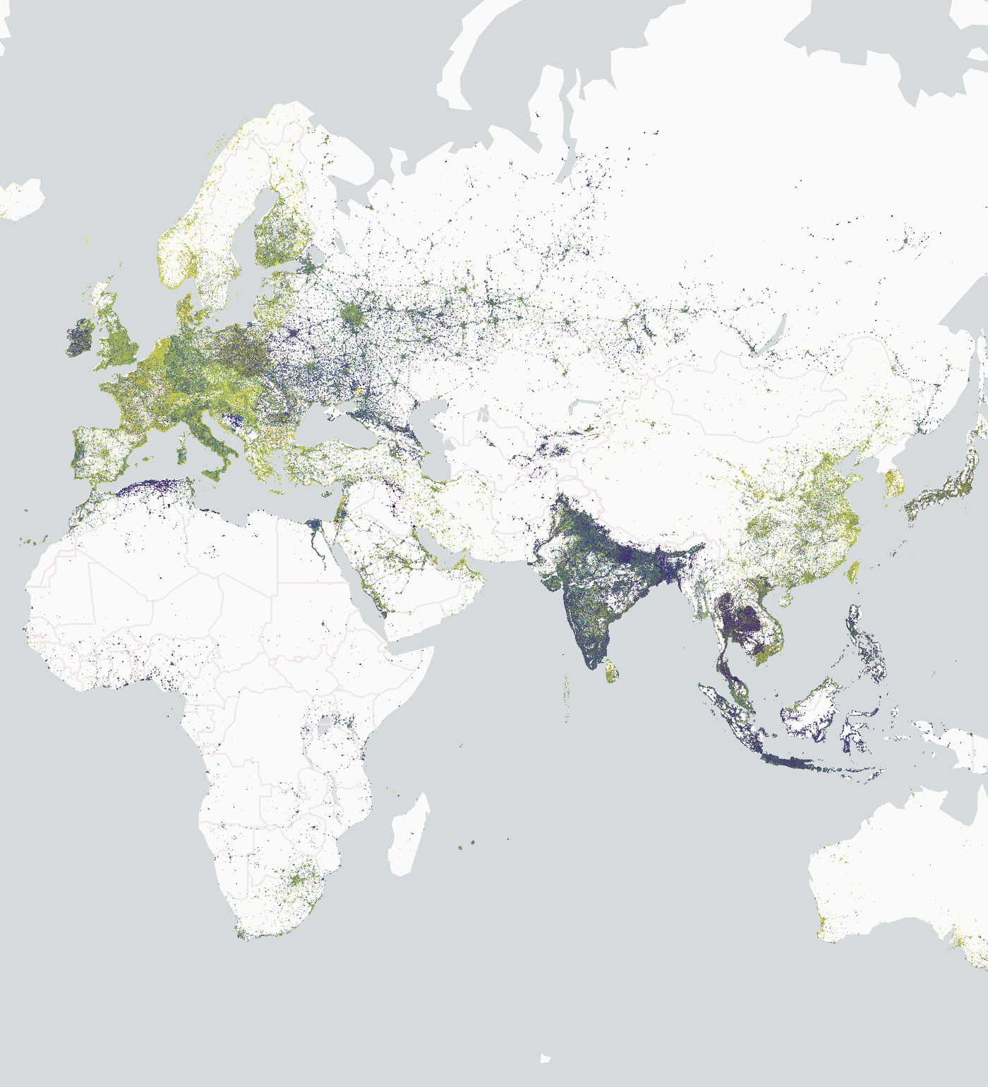
GeoArrow and GeoParquet in deck.gl
Kyle Barron
version5_final_revised_final.txt

Slide 2
Simpler, faster rendering of large analytical datasets in deck.gl

Slide 3
Data Flow for Web Maps
Load data into the browser.
Parse, manage in memory.
Copy to GPU & render to screen.

Slide 4
Data Flow for Web Maps
Load data into the browser. GeoParquet
Parse, manage in memory. GeoArrow
Copy to GPU & render to screen. deck.gl
Notes:
Going to go back to front

Slide 5
deck.gl Performance Optimization
GeoArrow
Performance guide recommendations:
Minimize data changes
Optimize accessors
Provide binary input
Core issue: high barrier to entry for binary input API
Users need to construct and manage binary arrays by hand

Slide 6
Attribute
Management
ScatterplotLayer
Attributes
Buffer Layout
instancePositions
instanceRadius
instanceFillColors
instanceLineColors
instanceLineWidth
[x0, y0, z0, x1, y1, z1, …]
[r0, r1, …]
[R0, G0, B0, A0, R1, G1, B1, A1, …]
[R0, G0, B0, A0, R1, G1, B1, A1, …]
[w0, w1, …]
From deck.gl Technical Deep Dive presentation
Notes:
This is the format that deck.gl ultimately needs on the GPU
Note how the buffer layout is columnar…
…if only there was a columnar, cross-language specification that makes it easier to construct these buffers

Slide 7
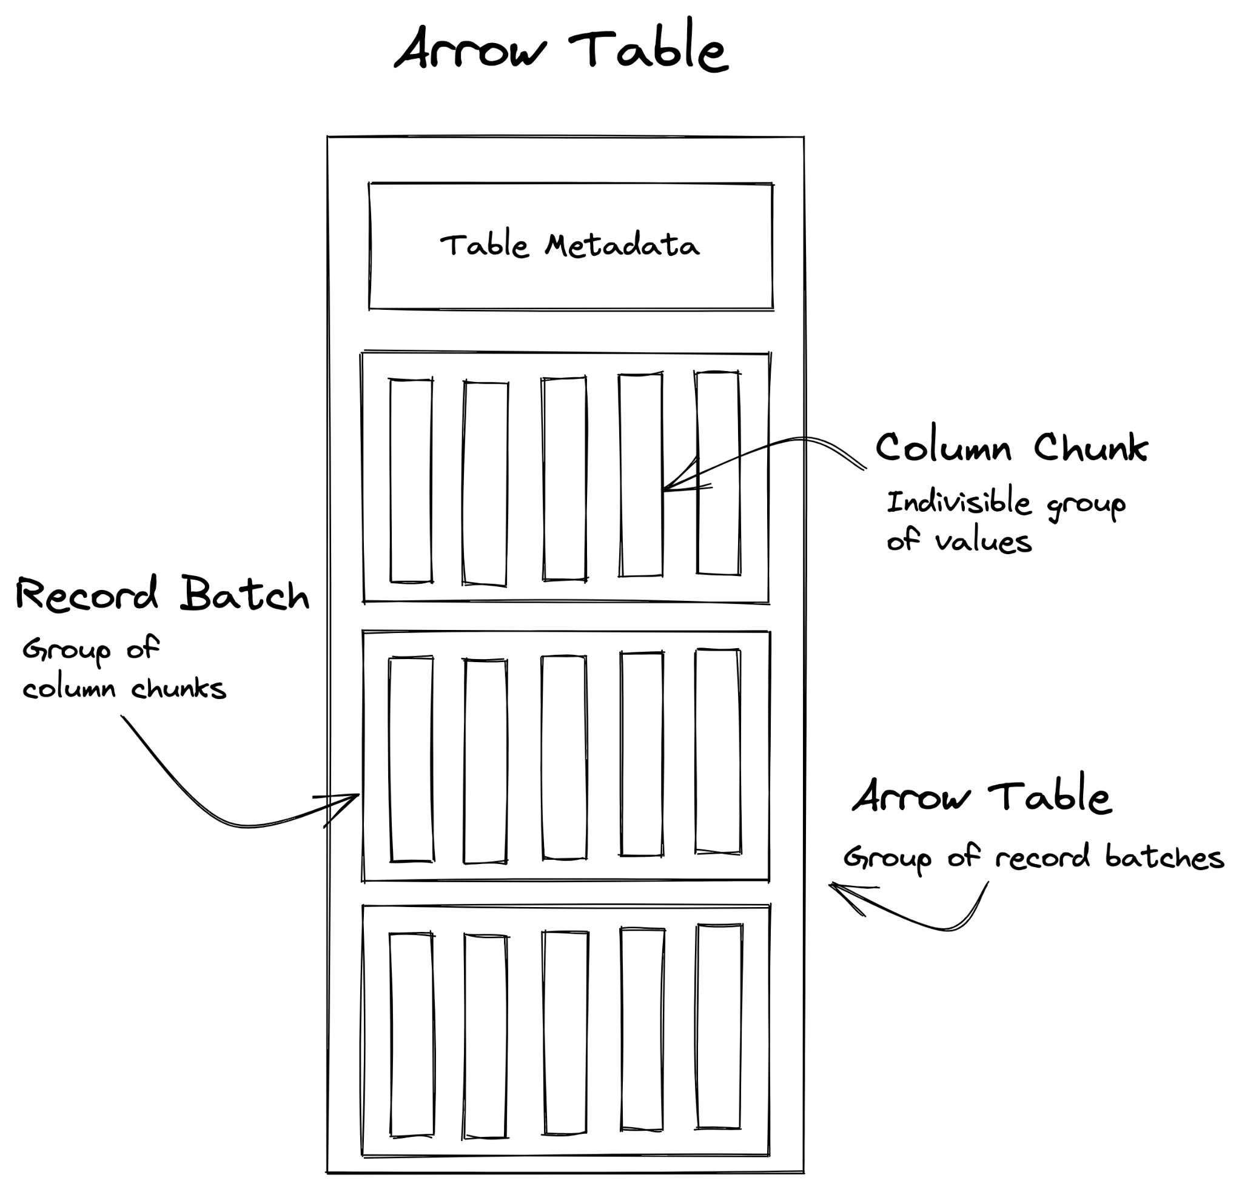
Apache Arrow
GeoArrow
Language-independent columnar memory format
Seamless data interchange
Ecosystem:
11 Implementations in JS, Python, R, C++, and more
DataFrame tools built on Arrow

Slide 8
GeoArrow
GeoArrow
Defines storage of geospatial data in Arrow
Full data type system of Arrow is available for attribute data.
Ecosystem:
GDAL 3.5+, GeoPandas
Can be loaded in non-spatial Arrow tools
Makes it easy for users to construct GeoArrow from their existing tools
Notes:
Doesn’t extend Arrow; stays within its bounds

Slide 9
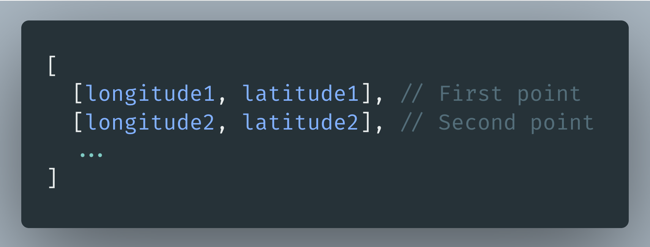
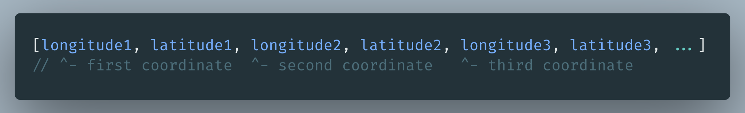
GeoArrow Point Representation
GeoArrow
Logical layout: FixedSizeList[2]<double>
Physical layout: Single Float64Array
Arrow provides access to both layouts.
Logical layout
Physical layout

Slide 10
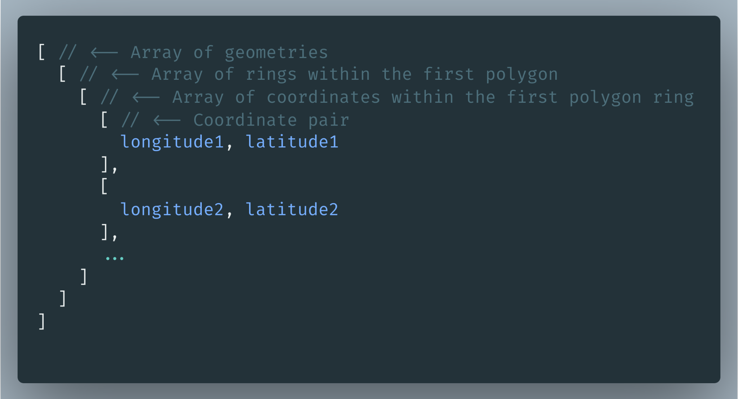
GeoArrow Polygon Representation
GeoArrow
Logical layout: List<List<FixedSizeList[2]<double>>>

Slide 11
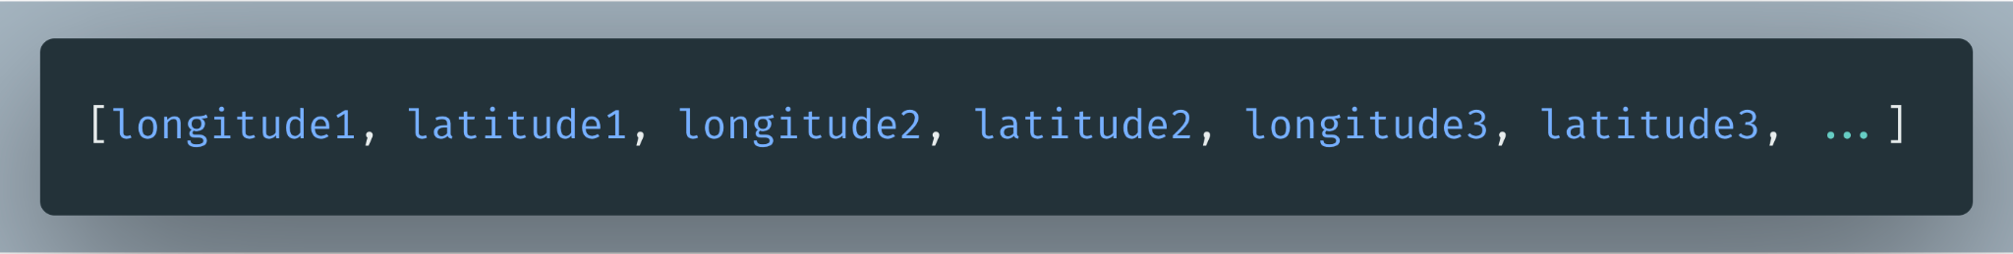
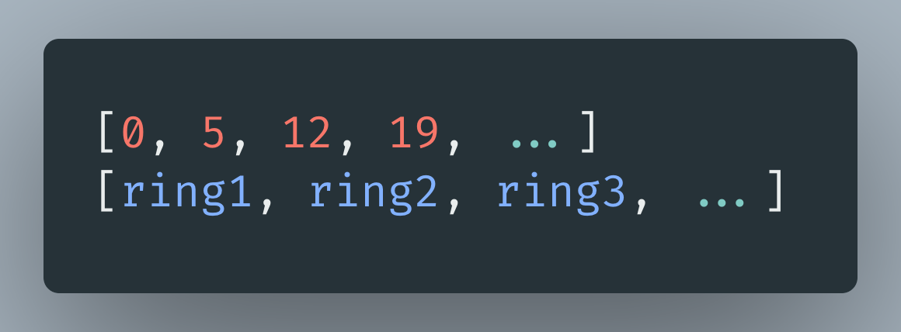
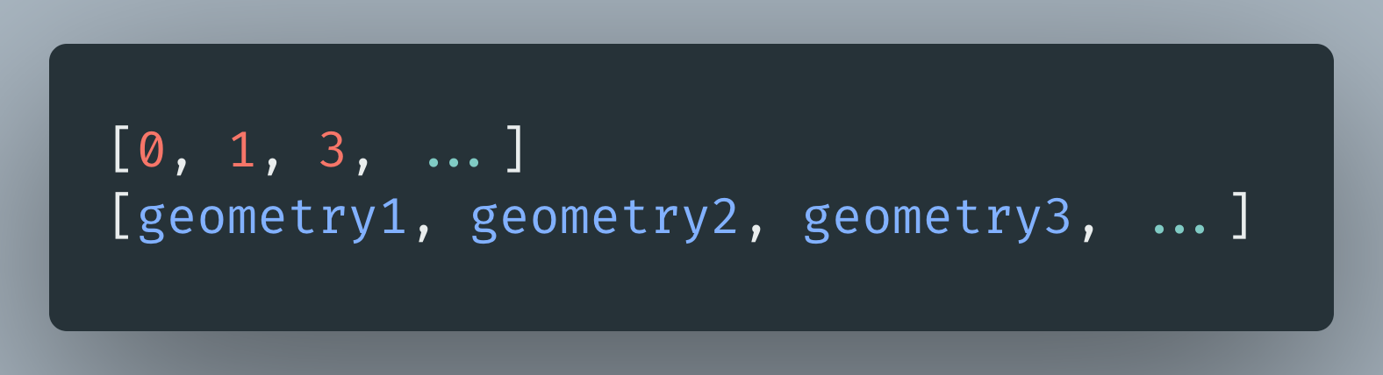
GeoArrow Polygon Representation
GeoArrow
Flat array of coordinates
Ring index array: index where each ring starts
Geometry index array: index where each geometry starts

Slide 12
GeoArrow and deck.gl
GeoArrow
GeoArrow generally compatible with deck.gl’s binary API
Avoid unnecessary memory copies, garbage collector overhead of GeoJSON
Pass in underlying Arrow arrays directly
ScatterplotLayer: GeoArrow Points
PathLayer: GeoArrow LineStrings
PolygonLayer: GeoArrow Polygons
TripsLayer: GeoArrow LineStrings + timestamp column

Slide 13
Getting GeoArrow into the Browser
Can we do better than loading GeoArrow directly?
GeoParquet

Slide 14
Bandwidth the Limiting Factor
GeoParquet
Efficient compression
Slower encoding/decoding on server/client can be worth better compression
Require less data
Tiling/spatial filters
Streaming downloads
Feels more responsive to render something before all data has downloaded
Notes:
What would be the ideal file format?

Slide 15
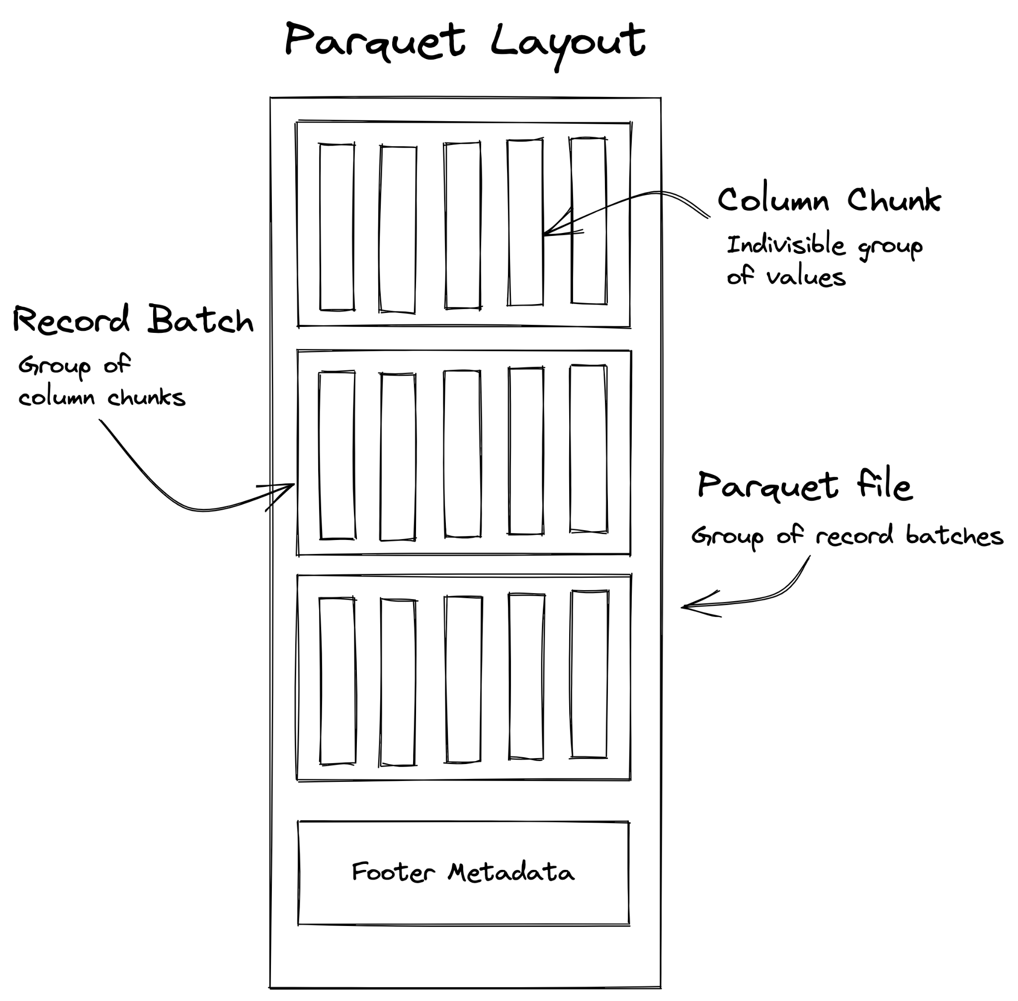
Apache Parquet
GeoParquet
Columnar file format
Compression per Column Chunk
Interoperable with the Arrow type system
Ecosystem:
Core implementations in C++, Rust, Java
High-level bindings in JS, Python, R
Widely supported in big data systems
Decoding Parquet gives you Arrow
Look familiar?
Notes:
Does this table

Slide 16
Parquet Support in JavaScript
GeoParquet
Complex specification, most pure JS implementations have been abandoned
Recent WebAssembly bindings to Rust Parquet libraries
Exclude features to reduce WASM size
Read-only no compressions: 235KB
Read-only all compressions: 732KB
https://github.com/kylebarron/parquet-wasm

Slide 17
GeoParquet
GeoParquet
Defines storage of geospatial data in Parquet
Current spec: WKB buffers
Parquet supports Arrow-native encoding, waiting for GeoArrow stabilization
Decoding GeoParquet will give you GeoArrow
Ecosystem:
GeoPandas, GDAL 3.5+
Can be loaded in non-spatial Parquet tools
Future support in Snowflake, BigQuery, Redshift

Slide 18
Efficient compression
GeoParquet
Encoding methods: RLE, Delta encoding
Compression options: Snappy, Gzip, ZSTD, LZ4, Brotli
 | GeoParquet (gzip) | GeoArrow | GeoArrow + gzip
NYC Taxi Data | 36 MB | 355 MB | 47 MB
Building Footprints | 60 MB | 121 MB | 62 MB

Slide 19
Require less data
GeoParquet
Footer contains per-column byte range & metadata
First load & parse footer
Selectively load columns, e.g. only geometry
Spatial filtering

Slide 20
Stream downloads
GeoParquet
Can’t stream… metadata is in footer
Read footer first via HTTP range requests
Then load each record batch async
Generate deck.gl layer per record batch

Slide 21
Examples
[Section title]

Slide 22
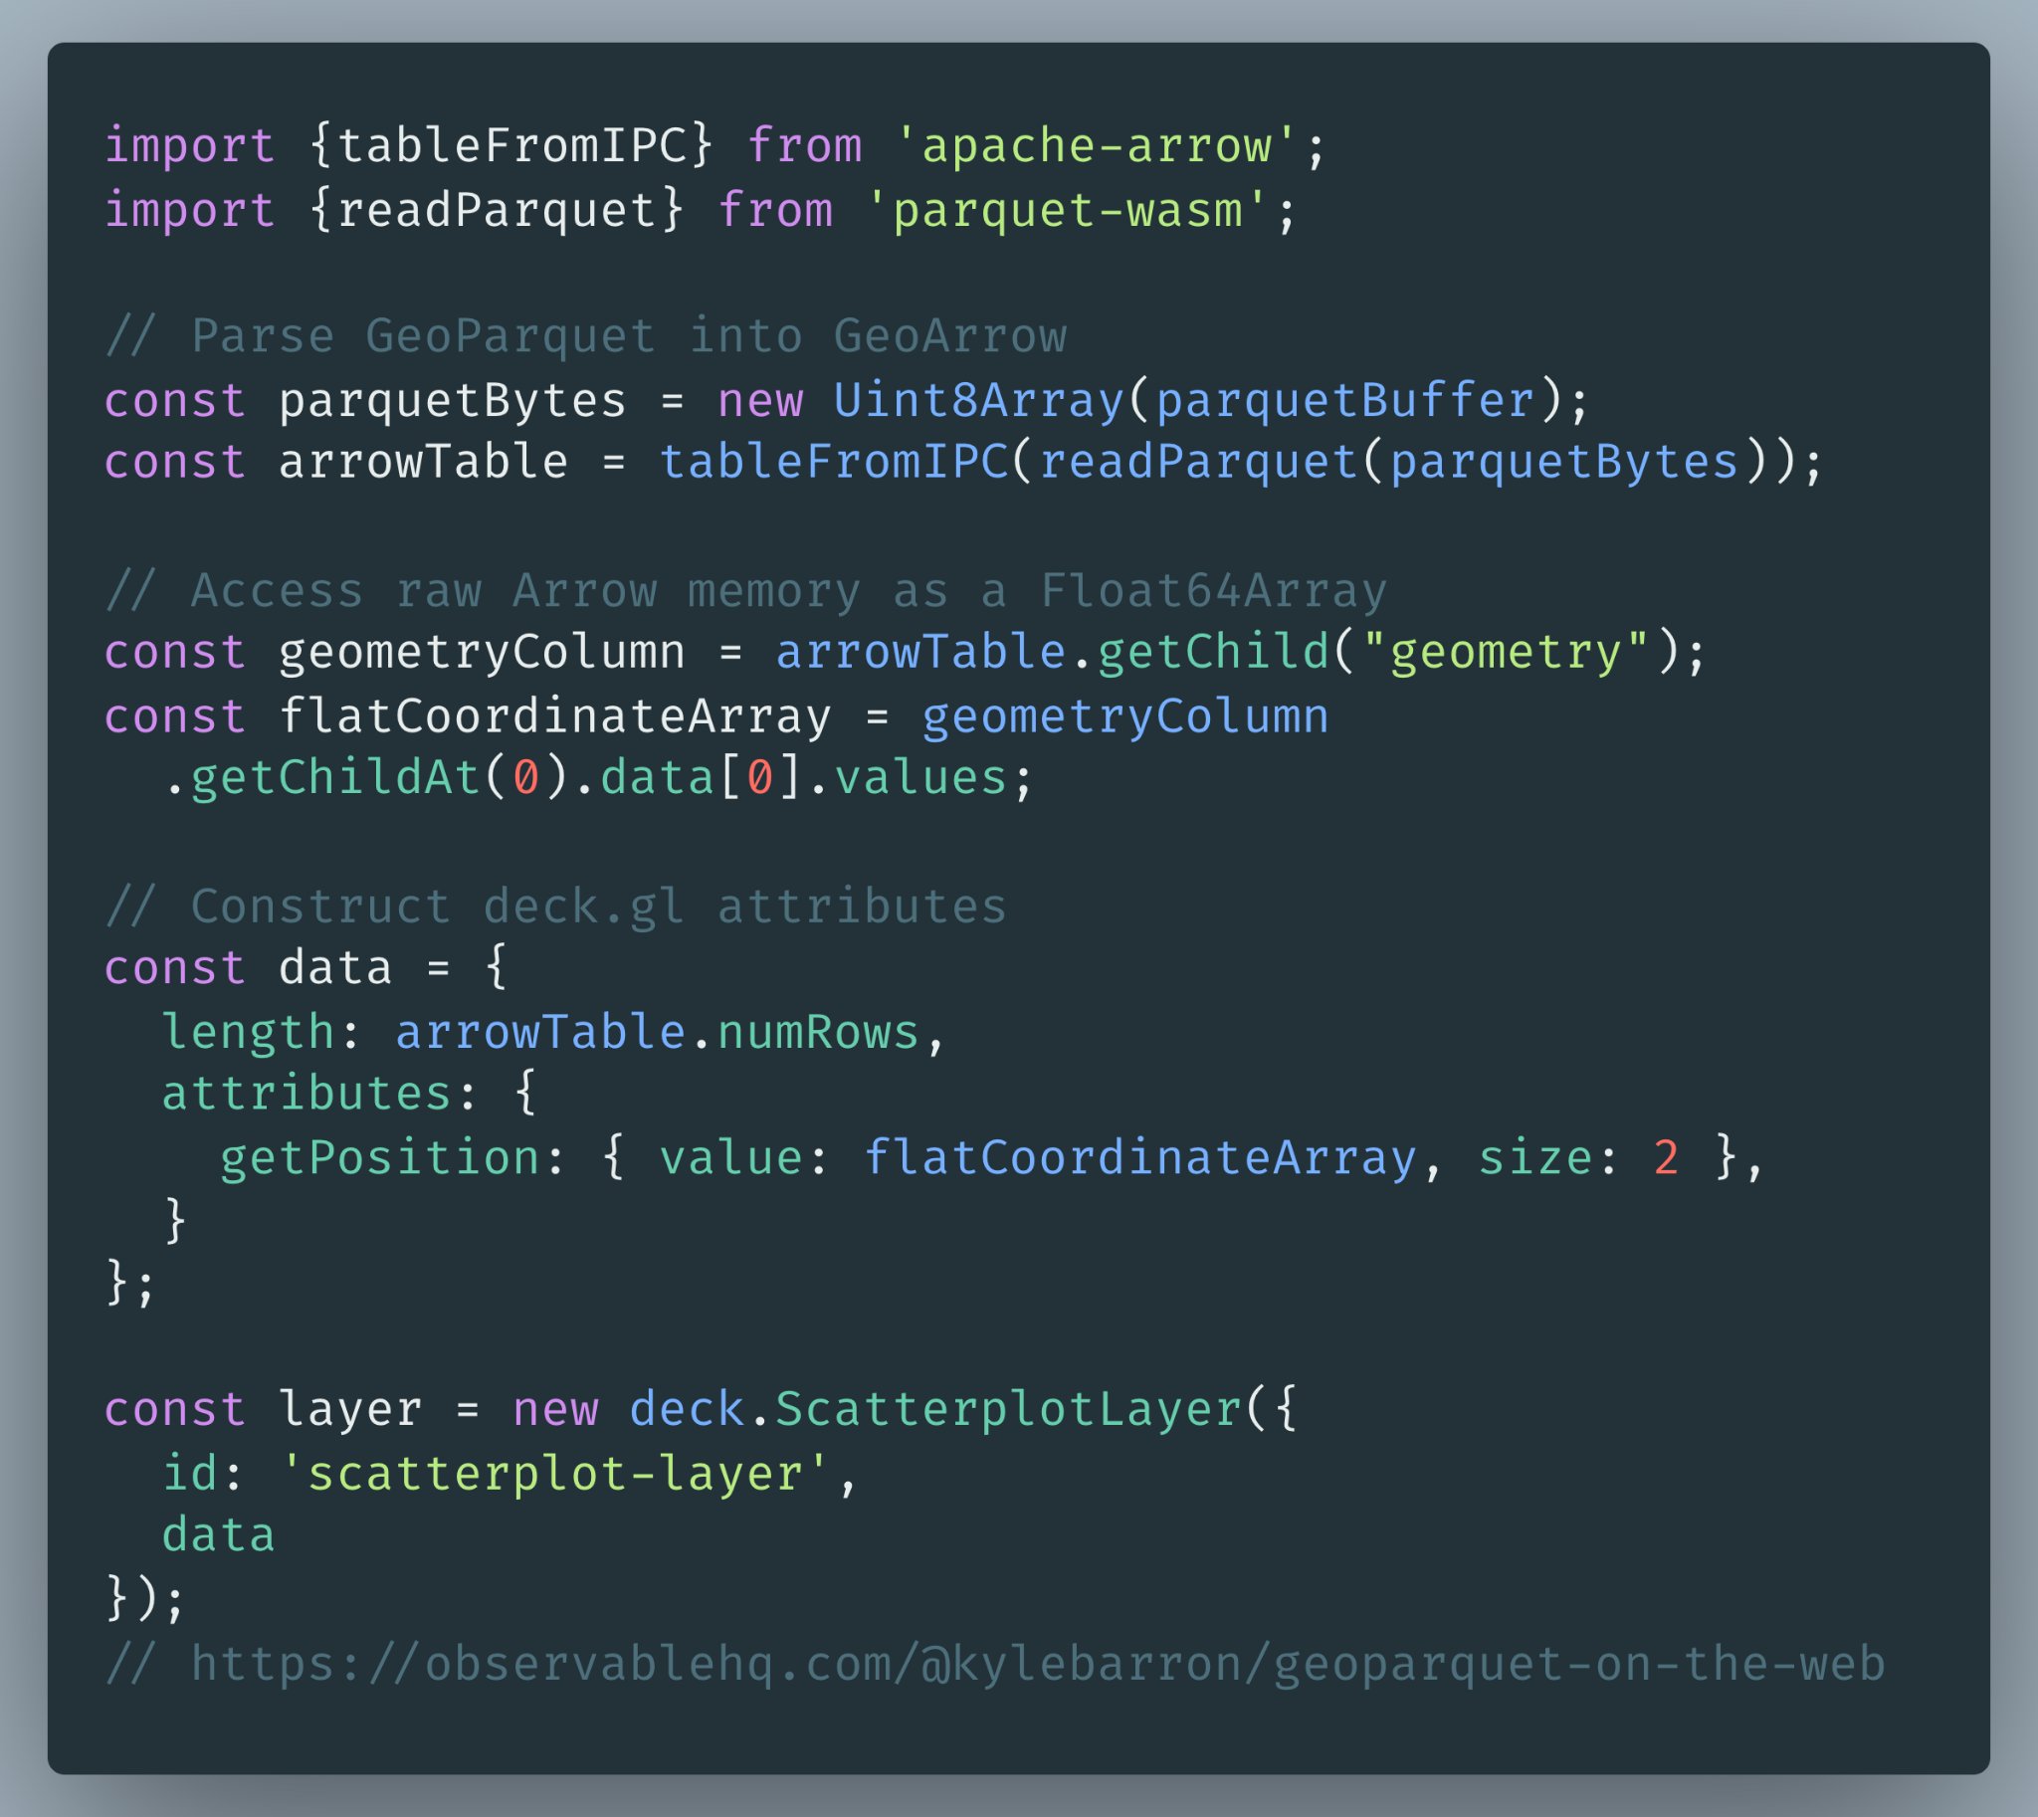
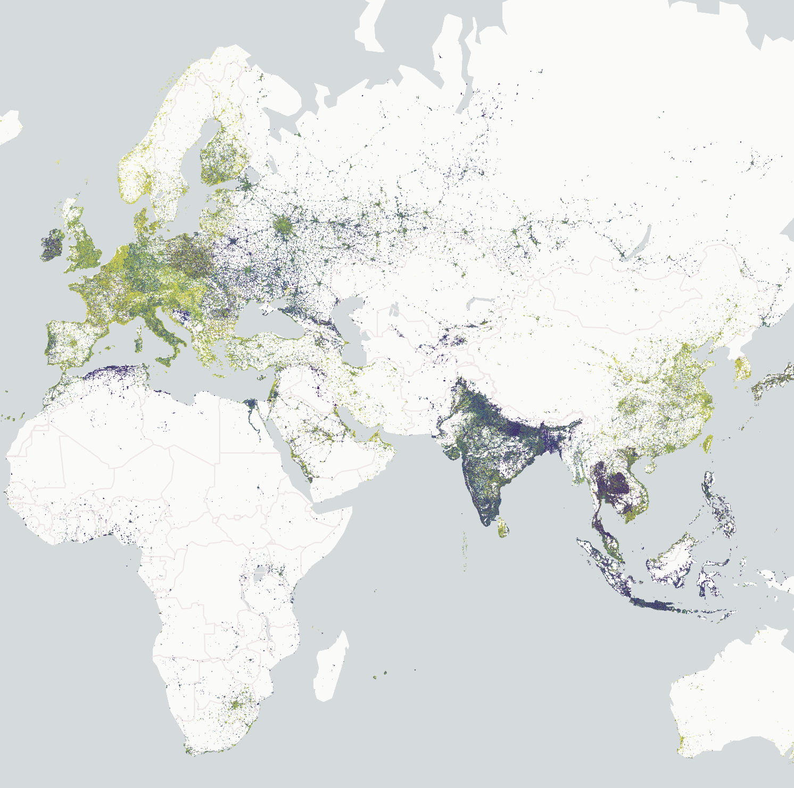
Example: 3.2M Points
Examples
https://observablehq.com/@kylebarron/geoparquet-on-the-web

Slide 23
Example: 3.2M Points
Examples
https://observablehq.com/@kylebarron/geoparquet-on-the-web

Slide 24
Example: 3.2M Points
Examples
https://observablehq.com/@kylebarron/geoparquet-on-the-web

Slide 25
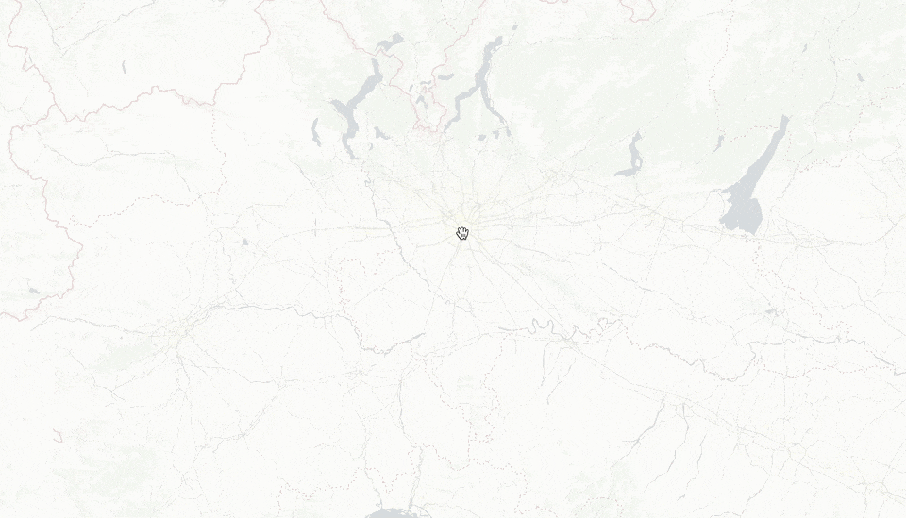
Example: 3.2M Points
Examples

Slide 26
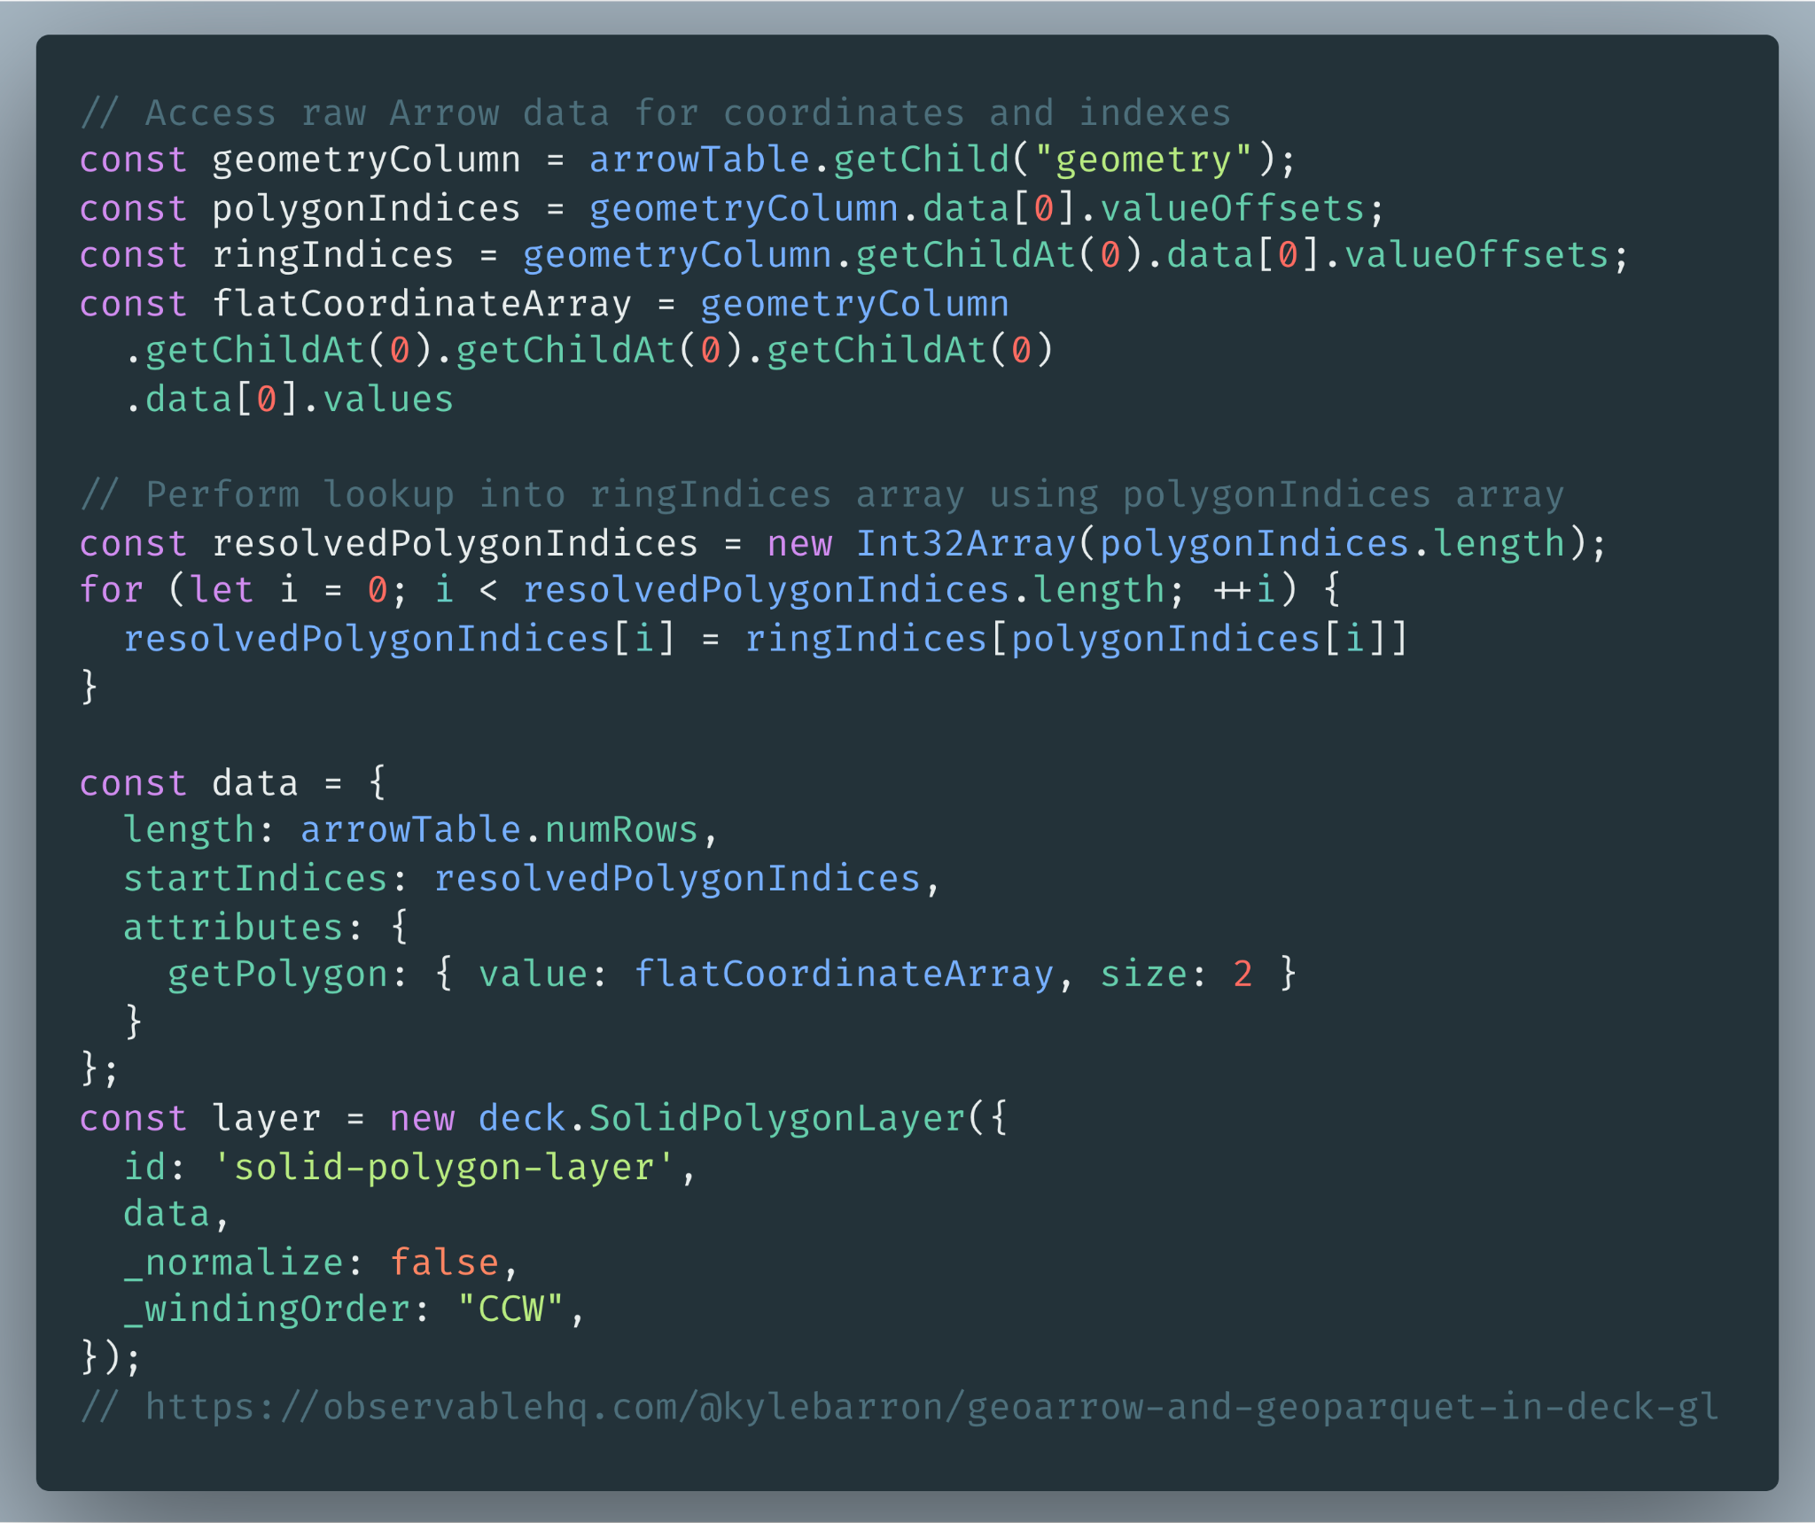
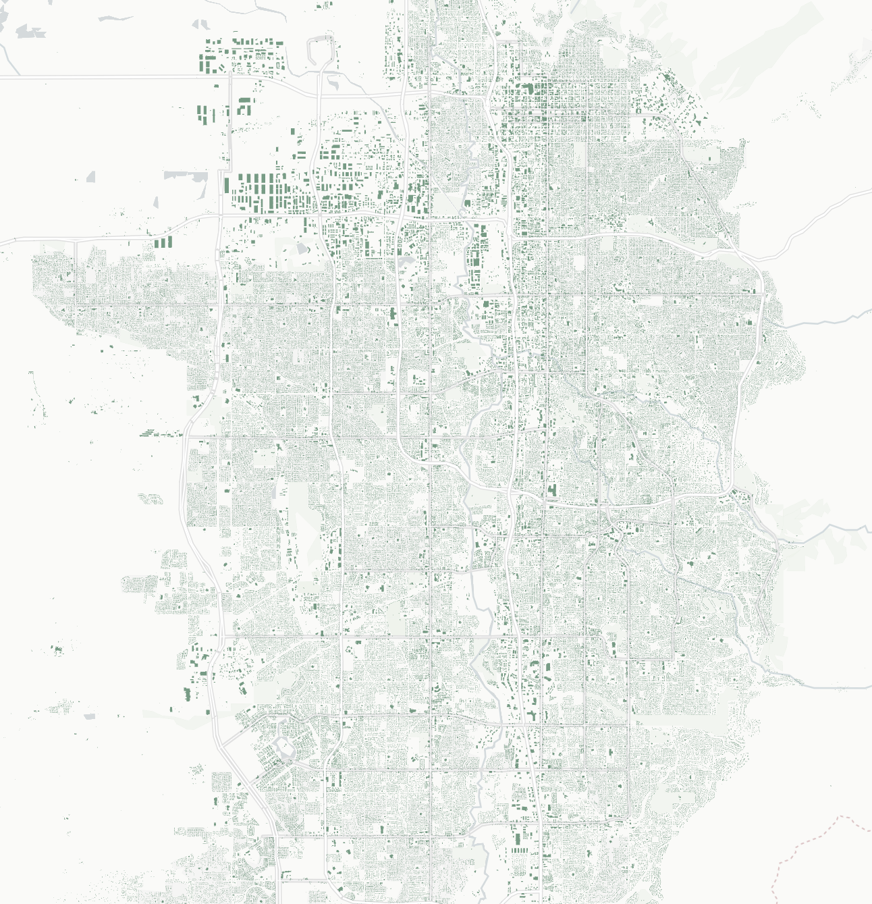
Example: 1M polygons, 7M coordinates
Examples
https://observablehq.com/@kylebarron/geoarrow-and-geoparquet-in-deck-gl

Slide 27
Example: 1M polygons, 7M coordinates
Examples
https://observablehq.com/@kylebarron/geoarrow-and-geoparquet-in-deck-gl

Slide 28
Example: 1M polygons, 7M coordinates
Examples
https://observablehq.com/@kylebarron/geoarrow-and-geoparquet-in-deck-gl

Slide 29
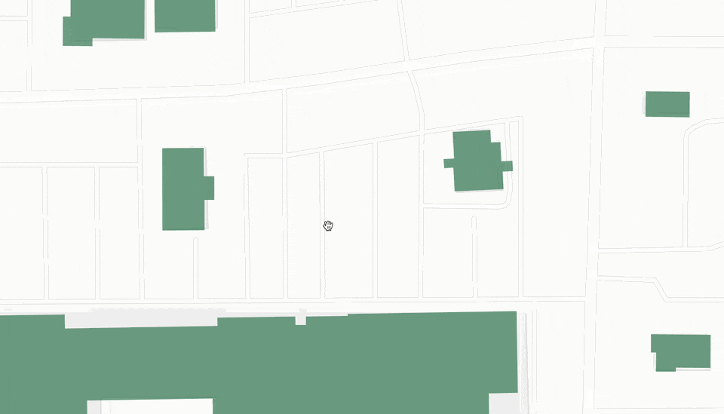
Example: 1M polygons, 7M coordinates
Examples

Slide 30
What next?
GeoArrow/GeoParquet not yet 1.0
Documentation for usage with deck.gl?
Future @deck.gl/arrow helper module?
Better @loaders.gl/parquet integration?
Arrow support in Pydeck?

